Slide 1



The BTL Edge: Turning Insight Into Opportunities
Liam Cooper
BDM
T. 07929 714540
E. liam.cooper@zephyrhomeloans.co.uk

Slide 2

Zephyr in brief
Award-winning BTL lender
Part of Topaz Finance
16th largest lender, 10th for BTL
A friendly team of BTL experts

Slide 3
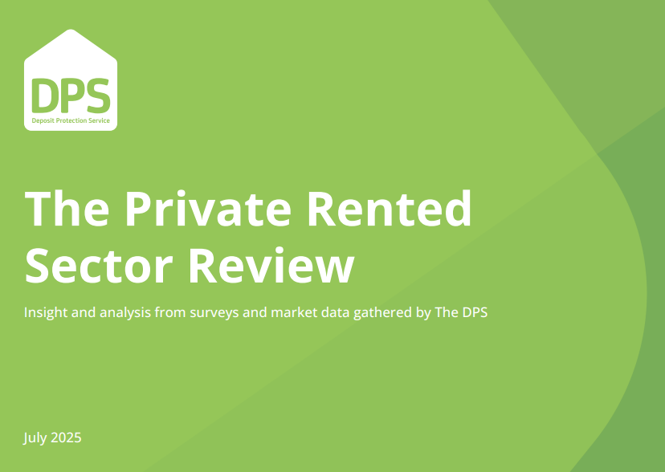


PRS insight from The DPS
Survey of 1100 landlords:
More than half (52%) are considering selling some or all of their properties.
25% of those respondents are considering exiting the market within two years.
Of the landlords who indicated they were considering selling some or all of their properties:
89% said changes or proposed changes in legislation or regulation was the reason.
74% said the level of returns after tax no longer made holding rentals inside the PRS attractive.
Scan to see the full story and report

Slide 4
Majority of professional landlords are here to stay!
78%
with three or more properties are not considering selling their properties in the next two years.
80%
with six or more properties are not considering selling their properties in the next two years.
18%
of landlords with a BTL limited company are considering buying more properties in the next two years.

Slide 5

Is there a lack of awareness of SPVs?
7%
Only
of landlords surveyed are structured as limited companies, despite over 53%
having 3 or more properties.

Slide 6
Incorporation into an SPV
Exponential growth in new BTL SPVs:
332% increase since 2016
401,744 BTL companies
58% of Zephyr apps are SPVs
Potential drawbacks:
Costs e.g. legal fees
CGT & stamp duty when
transferring property
Potential benefits:
Reduced taxation position
IHT planning
Source: Hamptons / Companies House

Slide 7

Another opportunity…
In another DPS survey, only 1% of landlords said they had an HMO, but…
HMOs could mean:
Higher yields
Higher borrowing capacity
Smaller deposit
Reduced rental voids

Slide 8
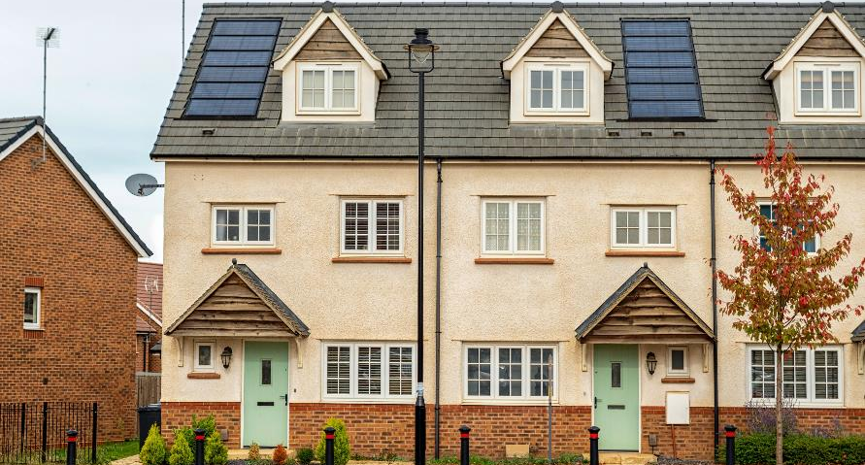

Diversifying portfolios to include HMOs
Standard Property
HMO
Value £575,000
Standard AST Rental Value £1,850
Personal @ 5.59% 5 year fixed £283,670 = 49% LTV
SPV @ 5.59% 5 year fixed £317,710 = 55% LTV
Value £575,000
HMO AST Rental Value £2,500 (£625 per room)
Personal @ 5.59% 5 year fixed £346,240 = 60% LTV
SPV @ 5.59% 5 year fixed £397,535 = 69% LTV

Slide 9

The Sky’s the Limit
with our BTL portfolio service
  One lender: save time and effort for you and your clients
  No limit on total portfolio loan amount
  Only one £200 app fee across all properties
  Background portfolio stress testing at 100% of mortgage payments
  One dedicated underwriter
  Bespoke broker service

Slide 10

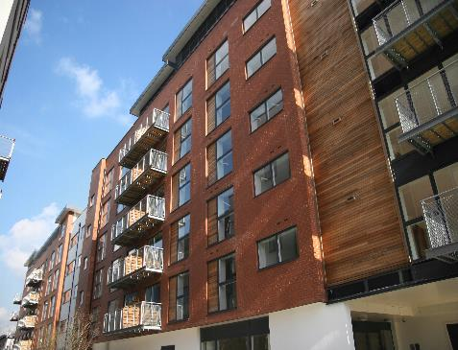


More opportunities
What?
Who?
How?
Houses & flats
HMOs & MUFBs
Flats above commercial
Ex LA & deck access
New build properties
SPV applications
Unlimited portfolios
Up to £2m loan size
Up to 4 applicants
Up to age 95 at term end
No min income
Top slicing available
Gifted deposits, equity
& inter-company loans
Capital raising
Plus, you’ll get a quality service and handholding from our friendly team of BTL experts

Slide 11





Here to help you and your landlord clients
0370 707 1894 BDMqueries@zephyrhomeloans.co.uk

